Slide 1

GlideX
ESP 32 Based Cycle rental system
BY-
Levin Mathews, 21ECB0F04
Seth Chodagam, 21ECB0F06
Vishnu Murali, 21ECB0F26
Indranil Athawle, 21ECB0F28

Slide 2

Introduction
The GlideX bicycle renting system aims to provide students a cheap and efficient way to traverse around the NITW campus.
It is a ESP32 based IOT project which houses several sensors that enables smooth operation of the cycle
Due to the technological advancements, with our everyday smartphones we are able to control and monitor the functionality of the cycle

Slide 3
Problem statement
As second year students, walking to and from blocks hostel to the ECE department was a real challenge
And owning a cycle was not feasible as well due to the in availability of cycle maintenance shops nearby and the hefty initial investment.
Hence we proposed a Bicycle rental system as an ideal solution. So GlideX came into existence

Slide 4
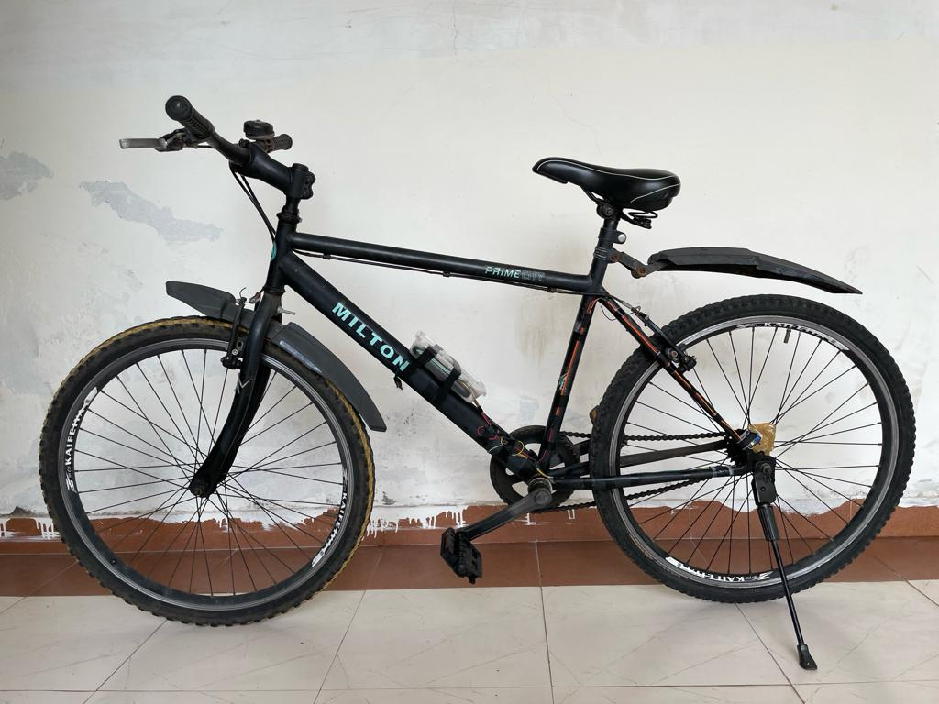
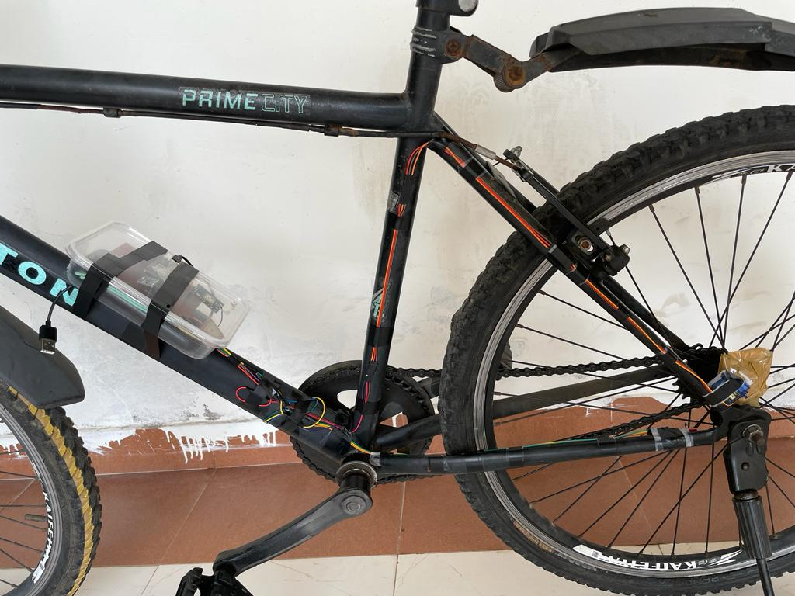
Prototype pictures

Slide 5
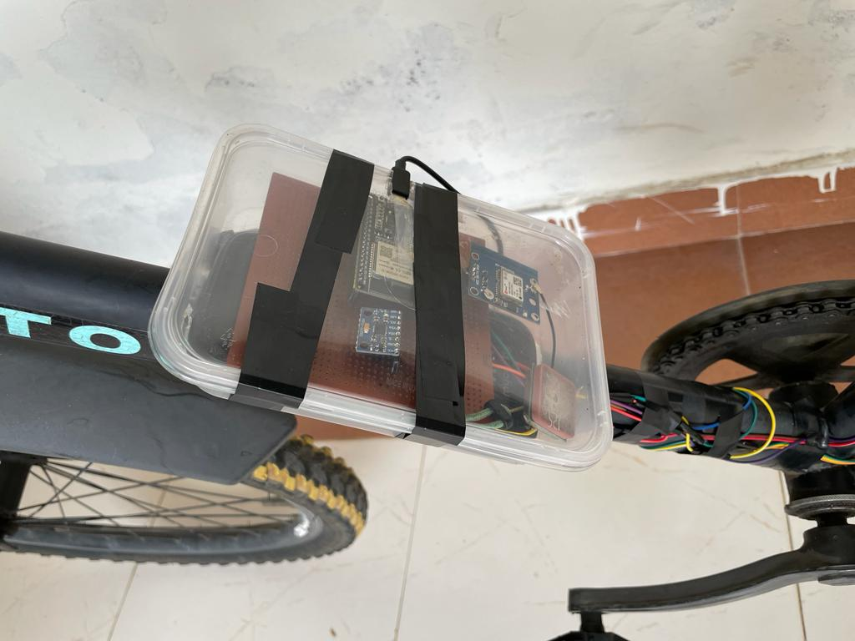
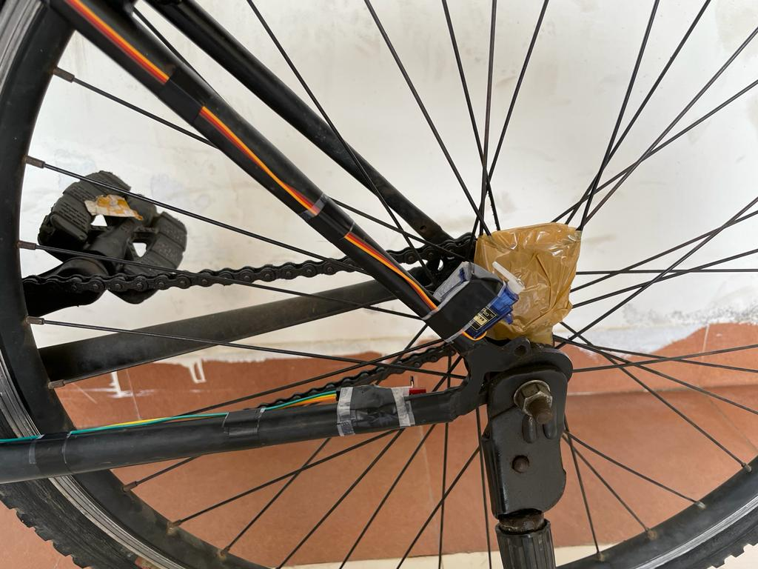
Prototype pictures

Slide 6
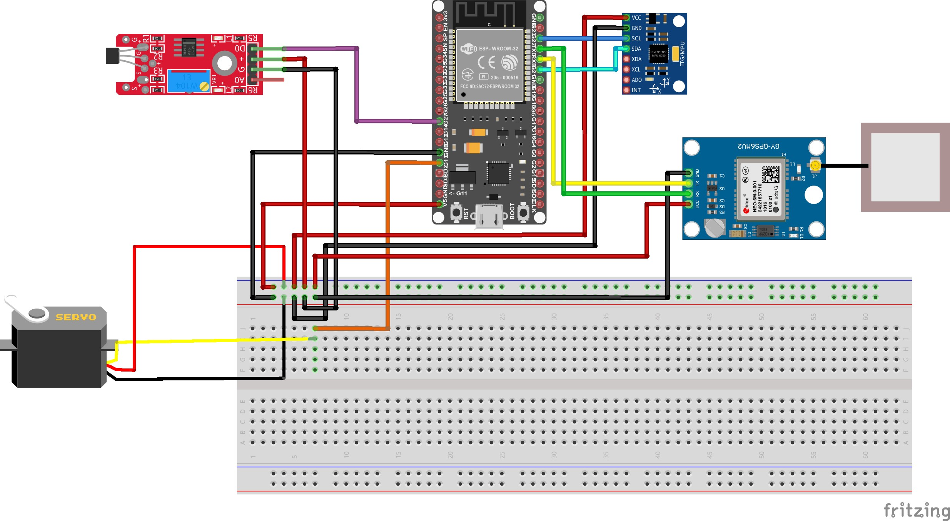
Circuit Diagram

Slide 7
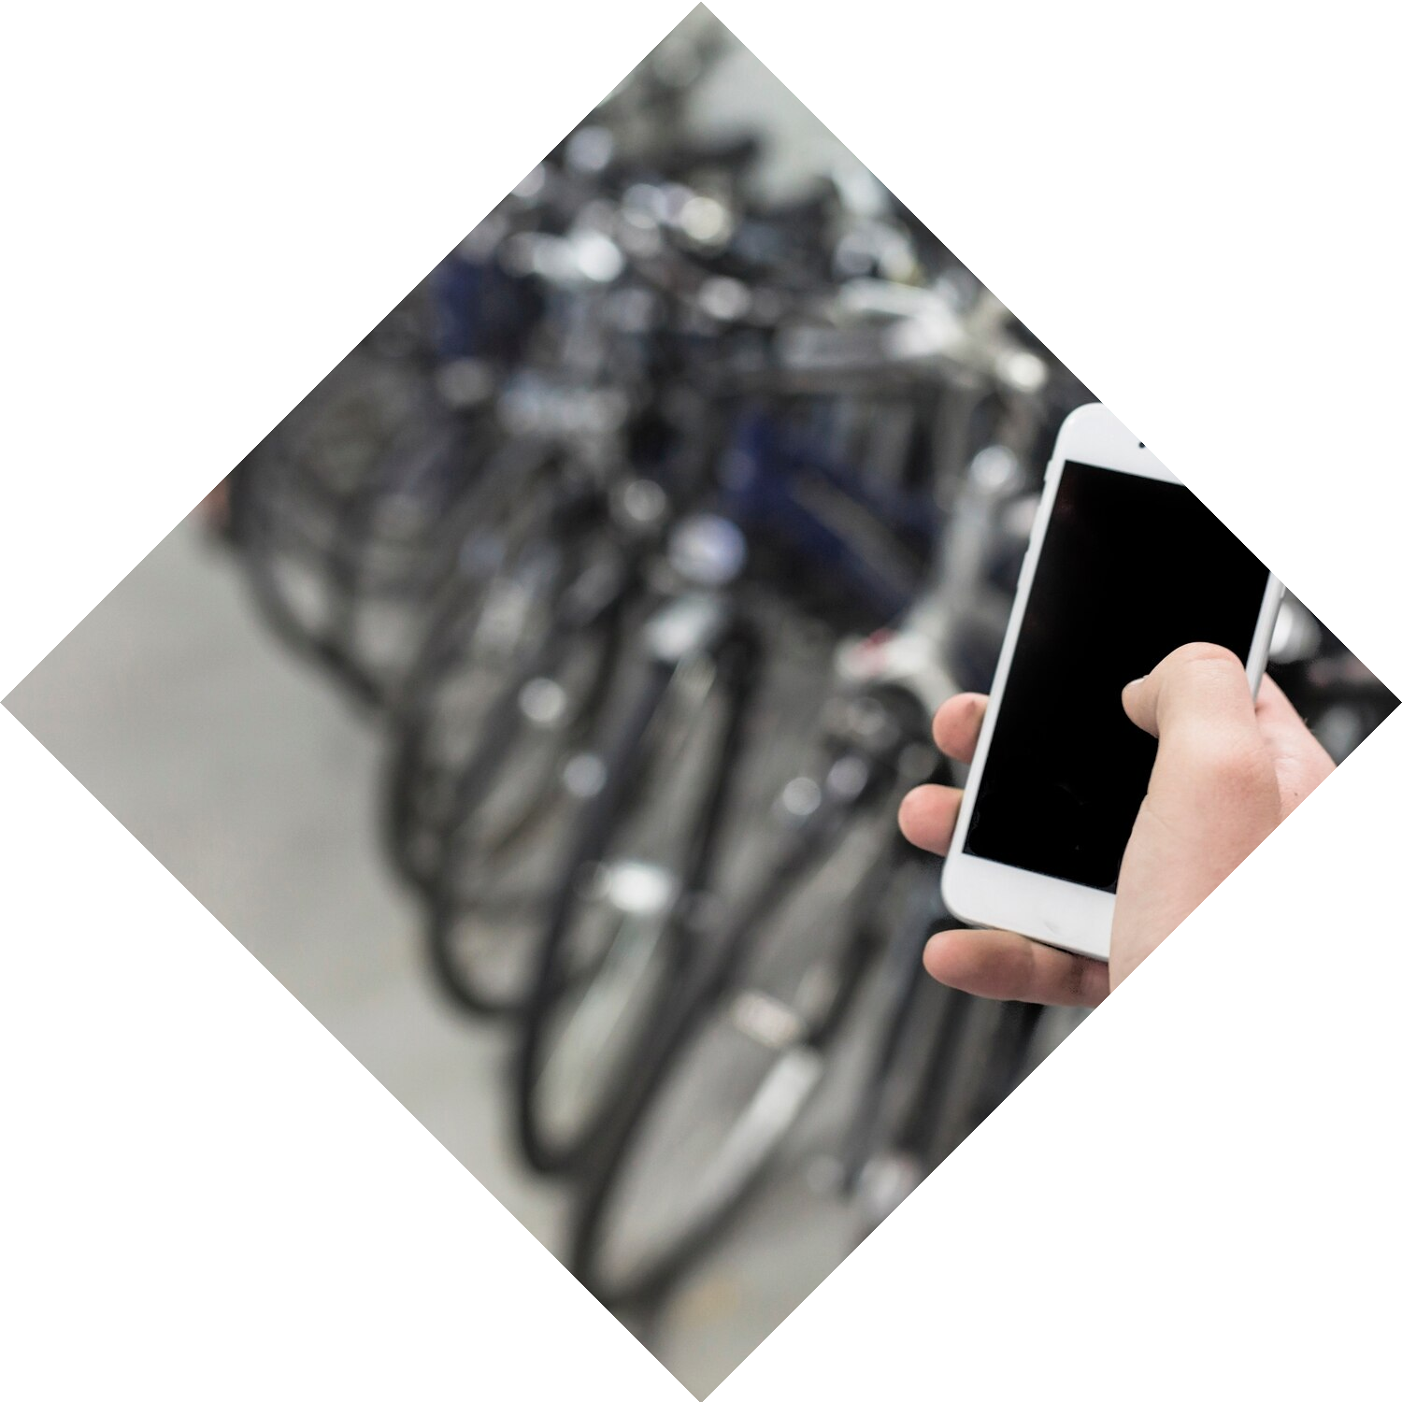

Technology Used
Http protocol- This protocol has been implemented to connect the ESP 32 to the internet using its built in WIFI module
Devices can connect to the website on local WIFI services or through mobile cellular connection.
This is accessed though WIFI port (80)
The WIFI protocol is also being used here
Satellite communication for the GPS module

Slide 8
Similar Companies
Companies that are implementing IOT based Bicycle rental system in India are –
Yulu: It is a Bengaluru-based bicycle-sharing startup that operates in over 20 cities across India. They use a fleet of smart bikes that are equipped with GPS tracking, IoT sensors, and a mobile app.
Pedalworks: It is a Mumbai-based bicycle-sharing startup that operates in over 10 cities across India. They use a fleet of GPS-enabled bikes that can be unlocked and locked using a mobile app.
Onn Bikes: Onn Bikes is a Hyderabad-based bicycle-sharing startup that operates in over 3 cities across India. They use a fleet of GPS-enabled bikes that can be unlocked and locked using a mobile app.

Slide 9
Cost of Components
Neo-6M (GPS) - 380 Rs
MPU 6050 (Gyro) - 40 Rs
KY-024 (Hall Sensor) - 50 Rs
SG 90 (Servo Motor) - 100 Rs
ESP 32 - 450 Rs
Jumper cable - 40 Rs

Slide 10
Future Scope
To use Industry Grade sensors
To improve the lock mechanism of the Bicycle
To improve the compactness of the system
To make the cycle electric

Slide 11
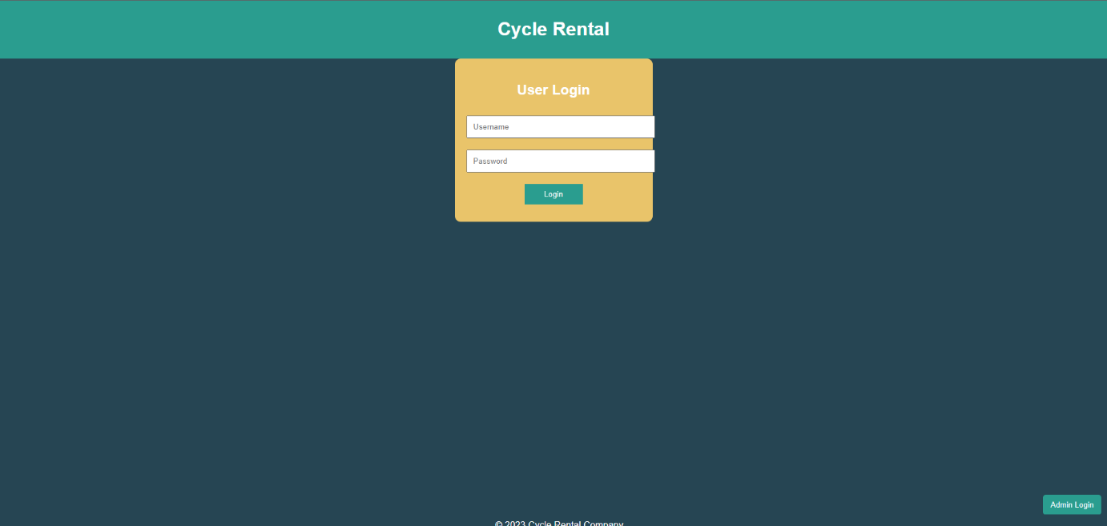
Website

Slide 12
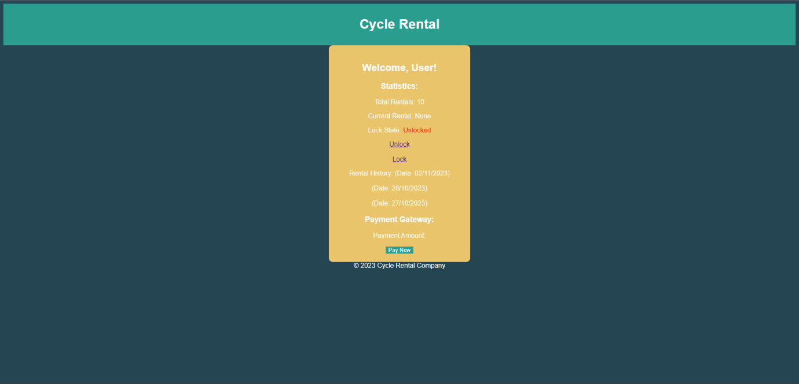
Website

Slide 13

Website

Slide 14
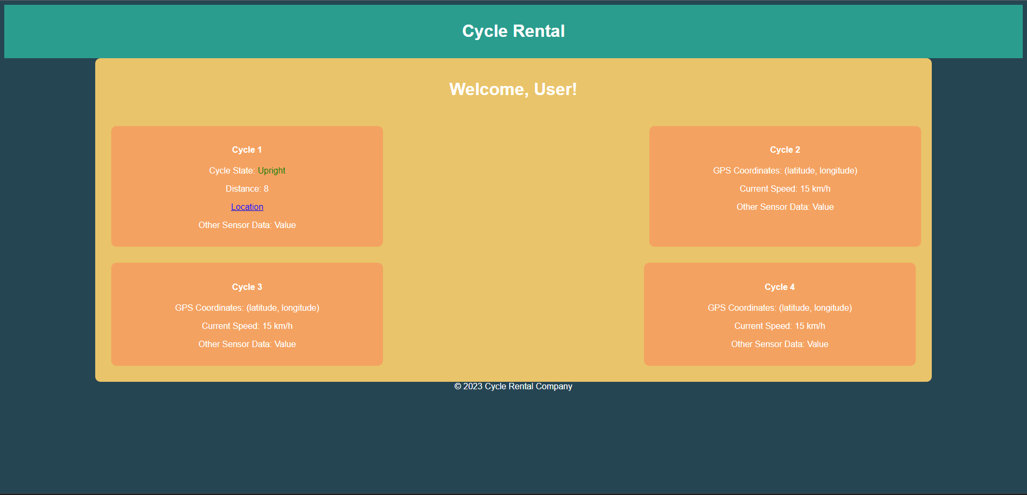
Website

Slide 15
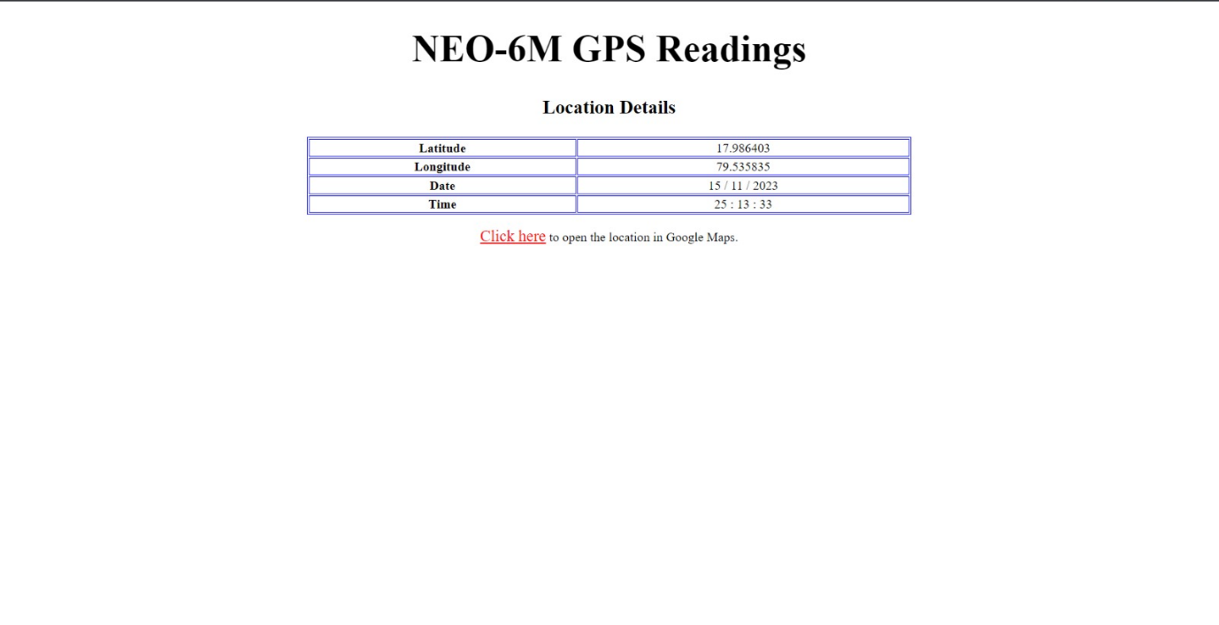
Website

Slide 16
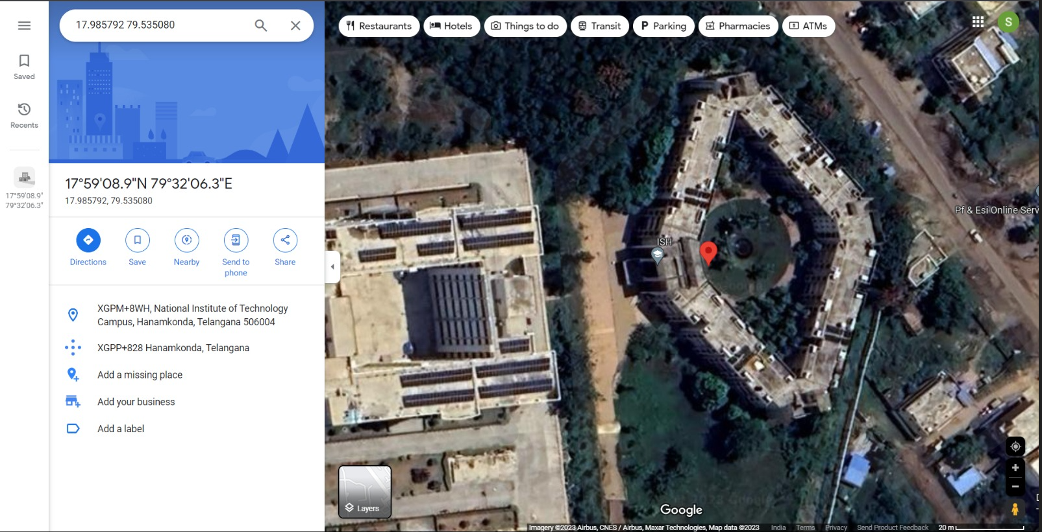
Website

Slide 17
Conclusion
The GlideX Bicycle rental system represents a signiﬁcant step towards revolutionizing urban mobility. By prioritizing sustainability, technology integration, and community engagement, this initiative will transform the way people commute in urban areas, promoting a greener and healthier future.

Slide 18
Thanks!

